Slide 1



Selenium C# Overview
Tien Phung
18 October 2022

Slide 2
1. What is Selenium
Table of Contents
Selenium IDE
Selenium WebDriver
Selenium Grid
Visual Code IDE
Selenium Installation for Visual Code
Selenium WebDriver Methods
Waits
Demo
Q&A

Slide 3

What is Selenium?
Selenium
Selenium IDE
Selenium WebDriver
Selenium Grid

Slide 4
What is Selenium ?
Selenium is a set of open-source web automation tools that leverages the power of web browsers and helps in automating workflows of how users interact with the web application within the browser.
The primary purpose of Selenium, as highlighted by the Selenium Website, is - "Selenium Automates Browsers, What you do with this power is entirely up to you"

Slide 5
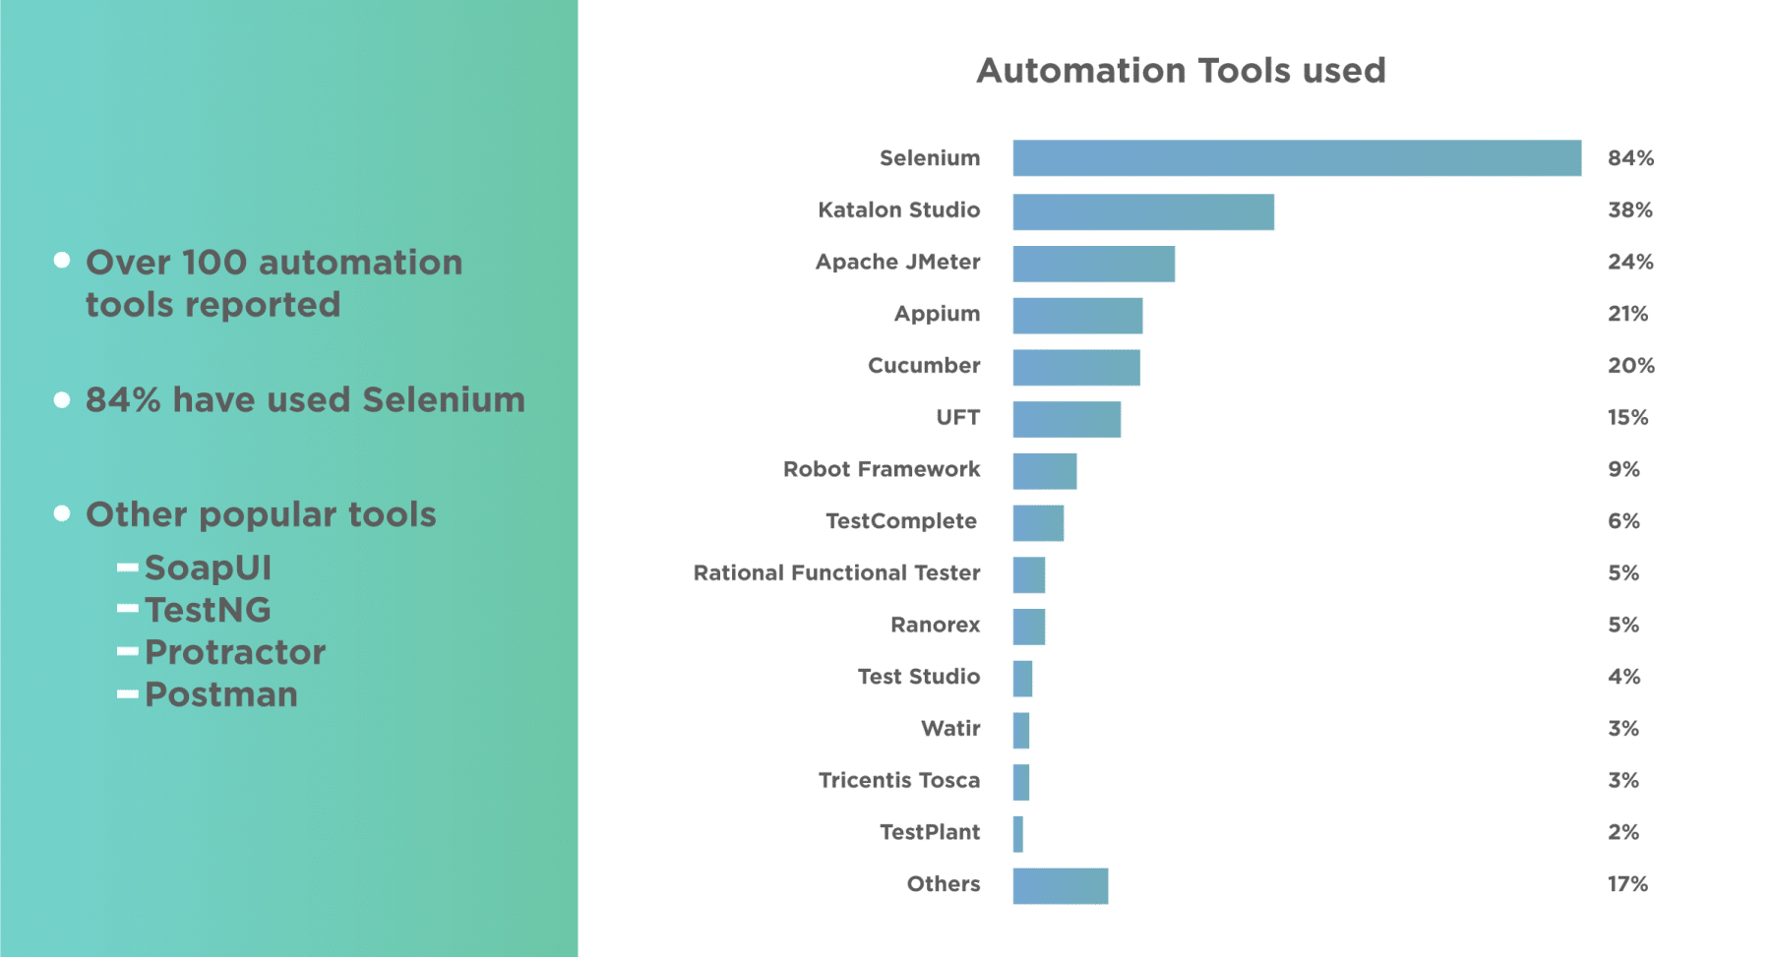
What is Selenium ?
Selenium is leading the board in the list of Web Automation tools and Automation Testing. The below survey conducted by Katalon depicts the popularity of Selenium:

Slide 6
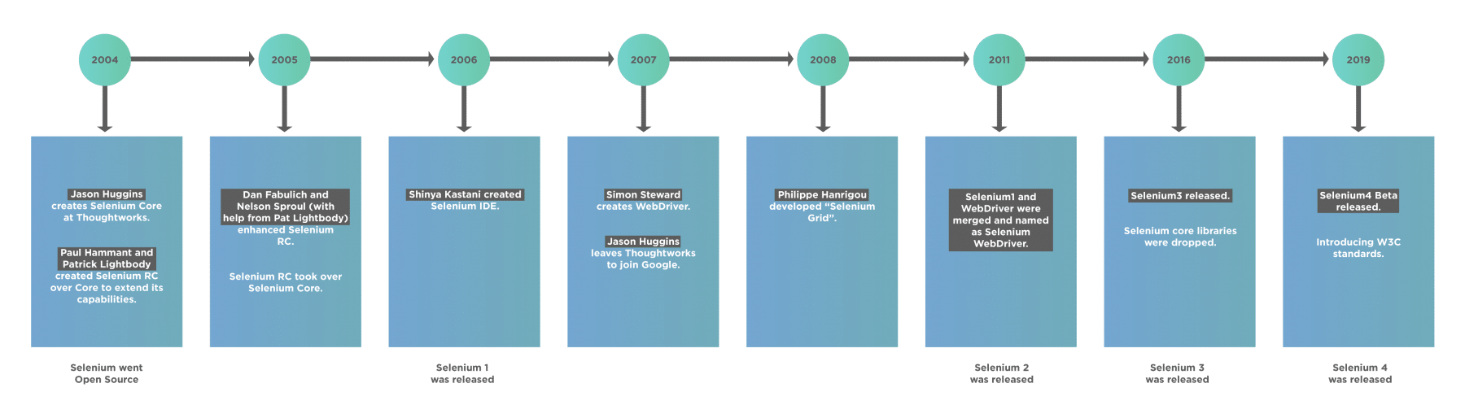
Selenium
How Selenium originated?
Sources: https://toolsqa.com/selenium-webdriver/selenium-testing/

Slide 7
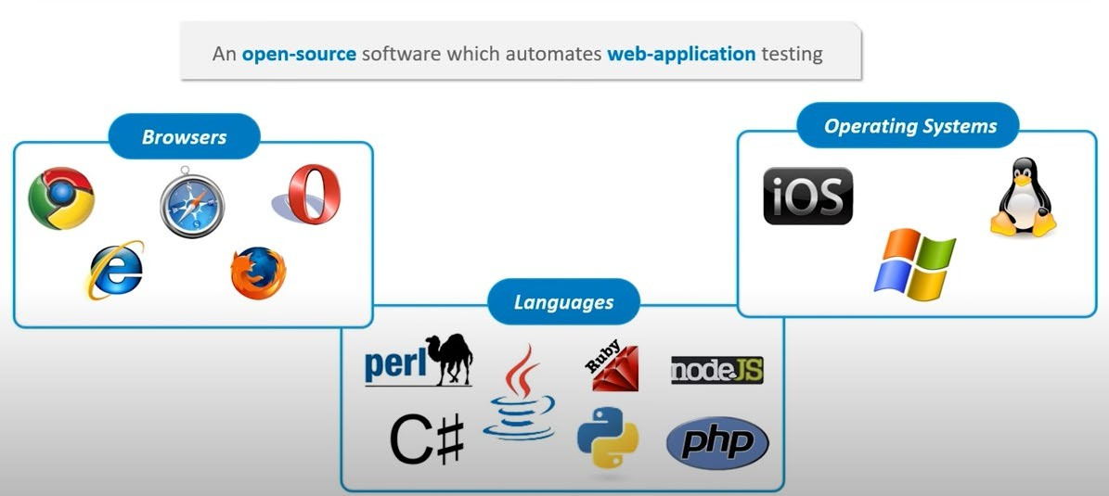
Selenium

Slide 8
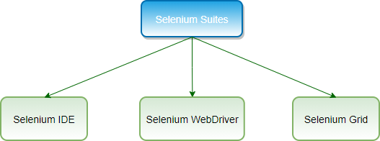
Selenium
Selenium is NOT a tool for doing automation
Selenium is an umbrella project encapsulating a variety of tools and libraries enabling web browser automation.

Slide 9
Selenium IDE

Slide 10




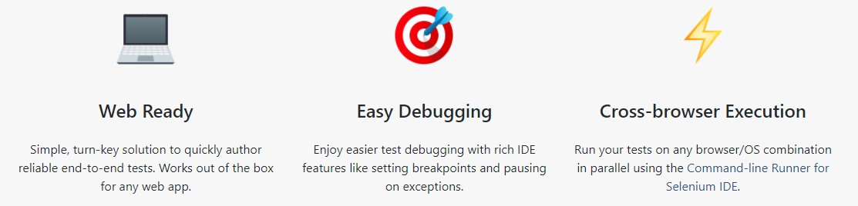
Selenium IDE

Slide 11
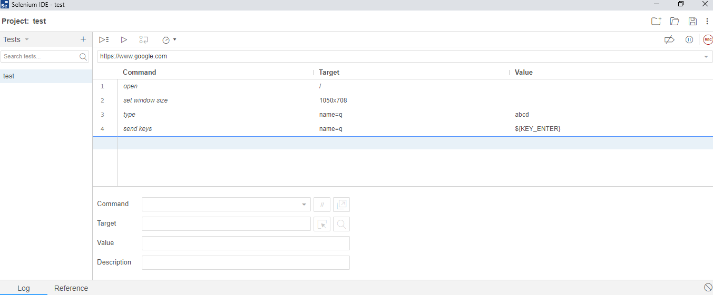
Selenium IDE

Slide 12


Selenium IDE
Pros:
Capability of record and play back
Flexibility test executing
Debug and set breakpoints supporting
Rich set of features and extensions
Logging capabilities
Parallel and cross-browser supporting
Cons:
Not suitable for testing extensive data, complex scenario
Not support database testing
Not support error handling
Report and failure capture missing

Slide 13
Selenium WebDriver

Slide 14
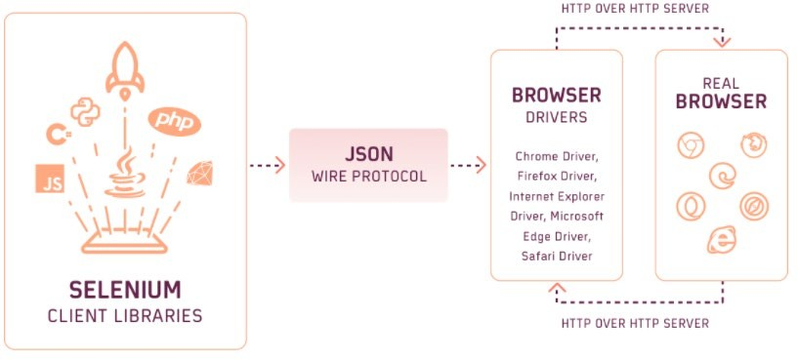
WebDriver JSON Wire Protocol in Selenium 3
Sources: https://www.lambdatest.com/blog/selenium4-w3c-webdriver-protocol/

Slide 15
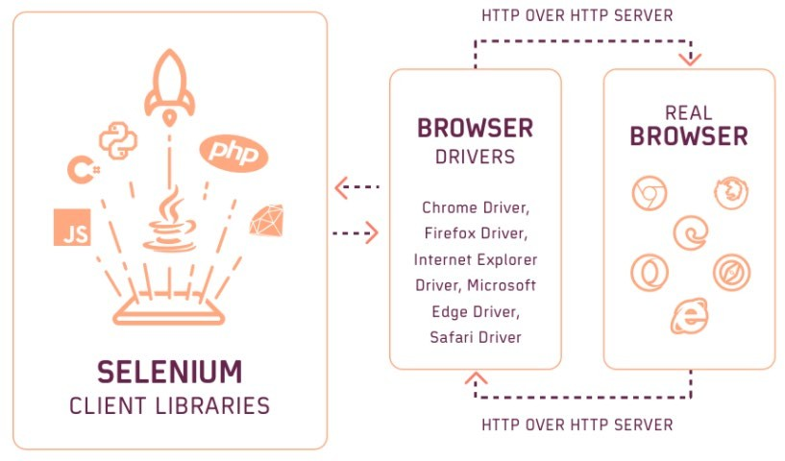
WebDriver W3C in Selenium 4
On October 13, 2021, Selenium 4.0 was officially released

Slide 16
Selenium WebDriver
Pros:
It’s totally free.
Interacts with Application Under Test in a more realistic way.
Supports multiple platforms, browsers and programming languages.
Cons:
Requires programming skill.
Only works with Web Application.
Open Source Tool difficult to get the immediate support.

Slide 17
Selenium Grid

Slide 18
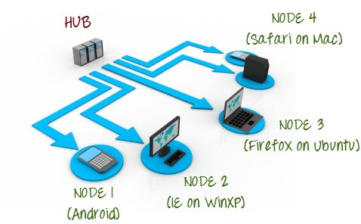
Selenium Grid

Slide 19
Selenium Grid
Purposes and main functionalities
Central entry point for all tests
Management and control of the nodes / environment where the browsers run
Scaling
Running tests in parallel
Cross-platform testing
Load balancing

Slide 20
Summary

Slide 21
Selenium
Selenium WebDriver makes direct calls to the browser using each browser’s native support for automation.
Selenium IDE is implemented as a browser extension, and allows you to record, edit, and debug tests.
Selenium Grid manages multiple environments from a central point, making it easy to run Selenium WebDriver tests against a vast combination of browsers/OS.

Slide 22
What Selenium can do?
Open Source – Unlike tools like QTP, Selenium is open source, which means that no cost is required to set up and use Selenium. Selenium is free to download and use.
Mimic User Actions – Almost all real-world user actions like button click, drag, and drop selection, checkboxes, keypresses, taps, scrolling can automate using Selenium.
Easy Implementation – Selenium is famous for being user friendly. Users can develop custom extensions for their use since code is open source.
Language Support – The most significant benefit of Selenium is the extensive support for various languages. Selenium supports maximum programming languages like Java, Python, JavaScript, C#, Ruby, Perl, Haskell, Go, among others.
Browser Support – Selenium can work on all the browser vendors that are out there. Selenium has support for Chrome, Firefox, Edge, Internet Explorer, Safari.
OS Support – Selenium bindings are available for all the primary OS like Linux, macOS, Windows.
Framework Support – Selenium supports multiple frameworks like Maven, TestNG, PYTest, NUnit, Mocha, Jasmine, etc. Selenium integrates well with CI tools like Jenkins, Circle CI, GOCD, Travis CI, Gitlab, etc.
Code Reusability – Scripts written for Selenium are cross-browser compatible. Same code can be run for multiple browsers using respective browser binaries and on separate machines in a Grid configuration,
Community Support – Since there are a lot of QA's working on this tool, it is effortless to find resources, tutorials as well as support on communities like Github, StackOverflow, etc.

Slide 23
What Selenium can't do?
No support to automate native desktop-based applications- Selenium can be used to automate web-based applications that run on web browsers. However, it cannot automate desktop-based applications.
No support for assertions and validity - Selenium provides control to the browser; however, providing assertions and checking mechanisms is not provided by Selenium. Selenium needs to pair with a testing framework like JUnit, TestNG, PyTest, etc. for assertions.
No support for image and code scanning - Automation of code scanning scenarios such as Bar code reading, CAPTCHA is not possible using Selenium.
No support for API Testing - Selenium mimics the user actions on the browser. So as such, Selenium doesn't give the capability of testing API.
No support for Performance Testing - Selenium cannot perform performance checks or performance testing of the web applications.
No inbuilt Reporting - Reporting capability is also not provided by Selenium. That is to say; reporting can be done only by pairing it with a framework like JUnit, TestNG.

Slide 24
Why use Selenium WebDriver for Web Automation?
Feature | Description
Dynamic Web Page Automation | Selenium WebDriver can automate dynamic websites where the content of pages changes by user actions.
Works Close to Browser | Browser vendors ship their WebDriver implementation. Hence they are tightly coupled to the browser giving a better testing experience.
Technology Agnostic | Selenium WebDriver allows you to automate the test cases for all the web applications, irrespective of the technology used for the development of the application under test.
Mimics Real User | Selenium WebDriver allows QA to mimic user actions on the websites. Selenium WebDriver can mimic typical user actions like form filling, clicking, double-clicking, key-press, as well as advanced user actions like drag and drop, click and hold, etc.
Supports Cross Browser Testing | Selenium WebDriver has the most significant advantage when doing cross-browser testing - where a QA can test for the same website, using the same piece of code on different browsers. It enables the verification and validation of test cases on multiple sets of browsers at the same time.
Supports parallel Execution | If there are more scripts to be executed on multiple browsers, then doing them one by one is time-consuming. So Selenium WebDriver allows parallel execution, using frameworks like TestNG, so that execution of test cases is faster. This allows large scale execution of test cases in a short time.
View Execution Results | Selenium WebDriver allows a QA to view the live execution of the automated test run on the computer system as well as on any other CI/CD pipeline machine by supporting functionalities like the screenshot, video-recording of test cases, etc.
Supports modern development techniques | Selenium WebDriver integrates very well with modern Software Development principles like Behaviour Driven Development via integration with the Cucumber library.

Slide 25
Visual Code IDE
Install Visual Code
Visual Code UI
Set up Visual Code for .Net Development

Slide 26
What is Visual Code ?
Visual Studio Code, also commonly referred to as VS Code, is a source-code editor made by Microsoft with the Electron Framework, for Windows, Linux and macOS. Features include support for debugging, syntax highlighting, intelligent code completion, snippets, code refactoring, and embedded Git. Users can change the theme, keyboard shortcuts, preferences, and install extensions that add additional functionality.
In the Stack Overflow 2021 Developer Survey, Visual Studio Code was ranked the most popular developer environment tool among 82,000 respondents, with 70% reporting that they use it.

Slide 27
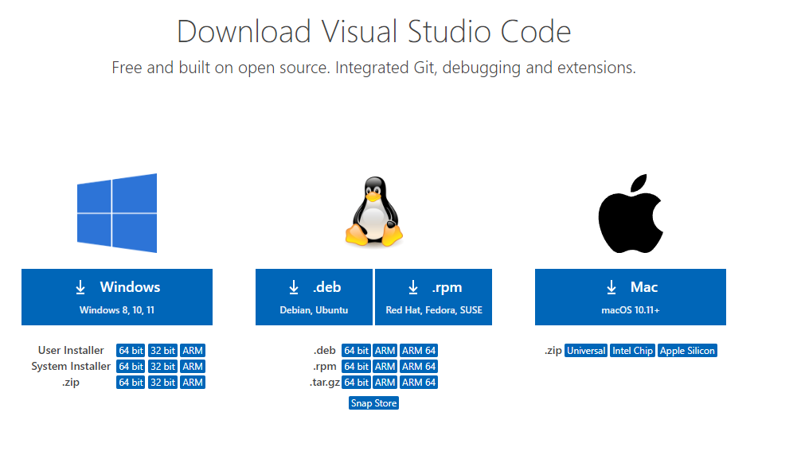
1. Install Visual Code
https://code.visualstudio.com/download

Slide 28
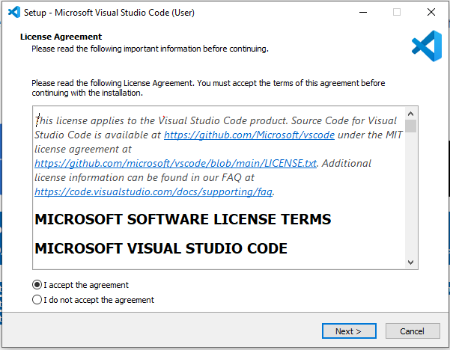

Slide 29
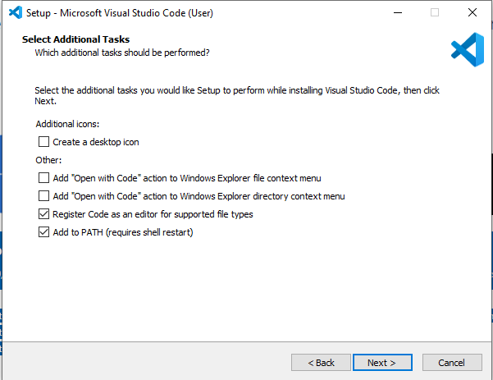

Slide 30
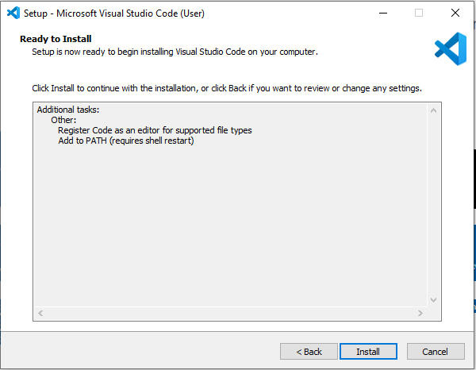

Slide 31
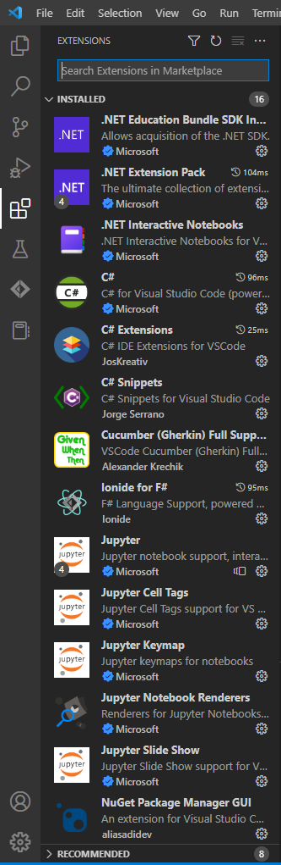
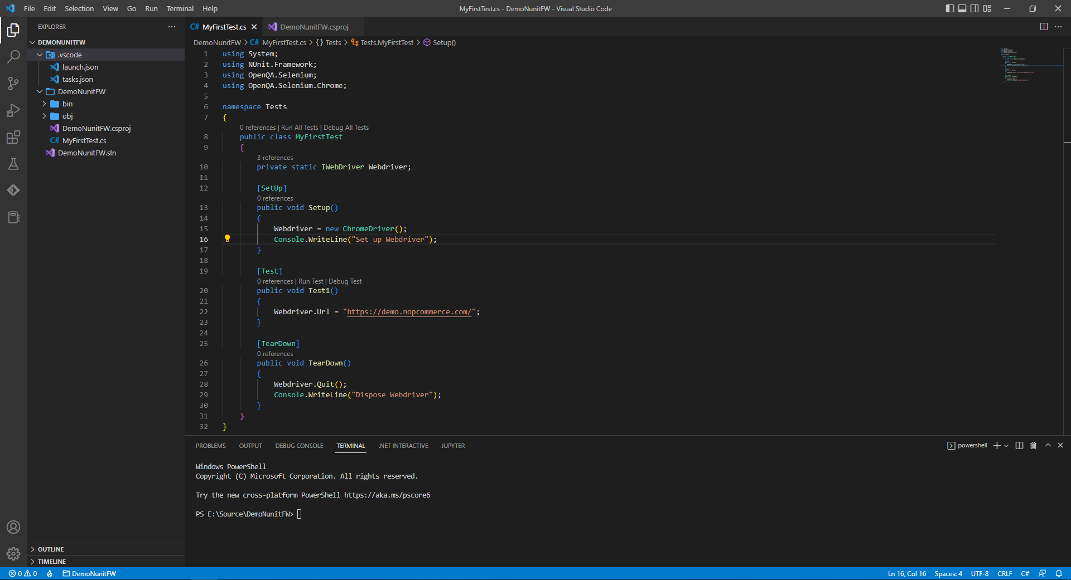
2. Visual Code UI

Slide 32
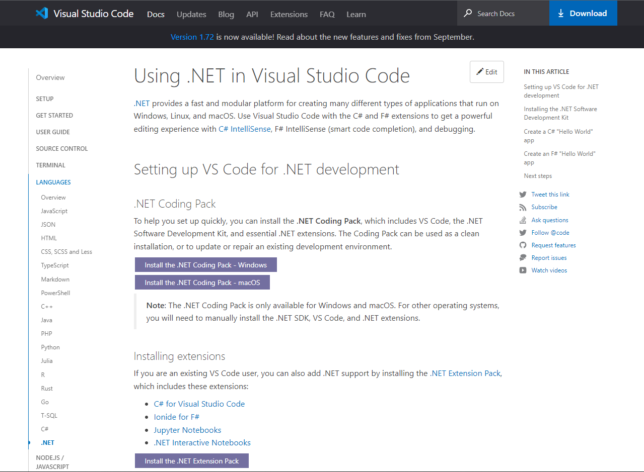
3. Set up Visual Code for .Net Development
https://code.visualstudio.com/docs/languages/dotnet

Slide 33
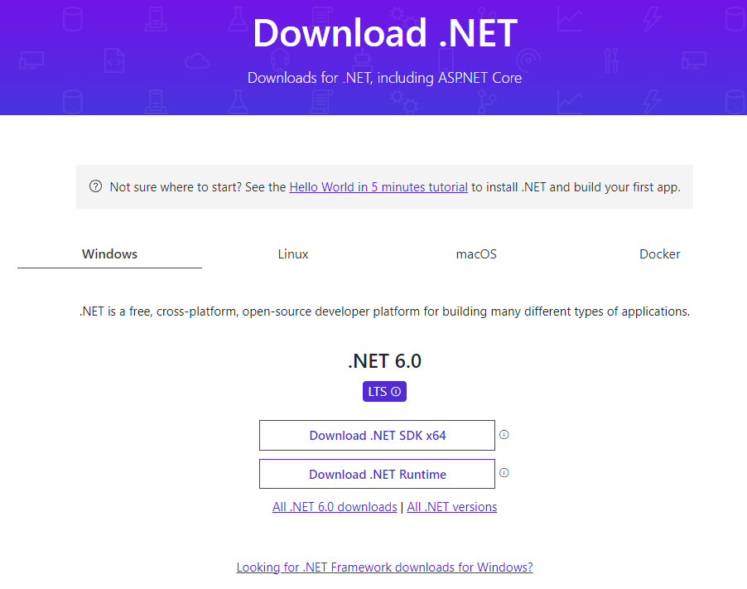
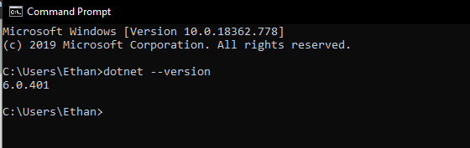
Install dotnet sdk
https://dotnet.microsoft.com/en-us/download

Slide 34
Selenium Installation for Visual Code

Slide 35
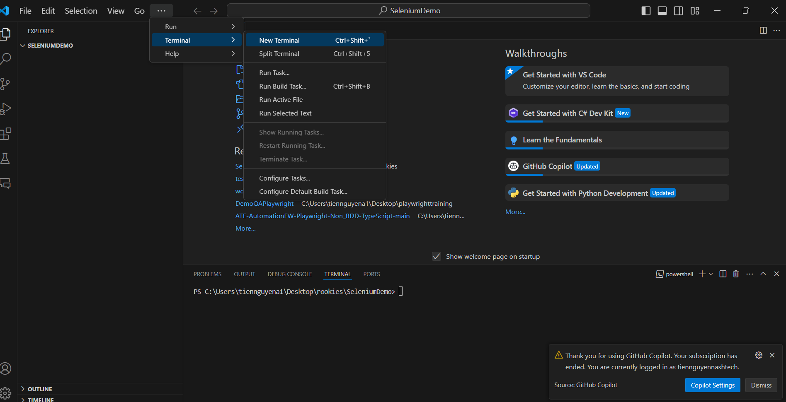
Create new folder for containing project
Create empty new folder then open this folder in Visual Code. Then we open terminal window in Visual Code

Slide 36
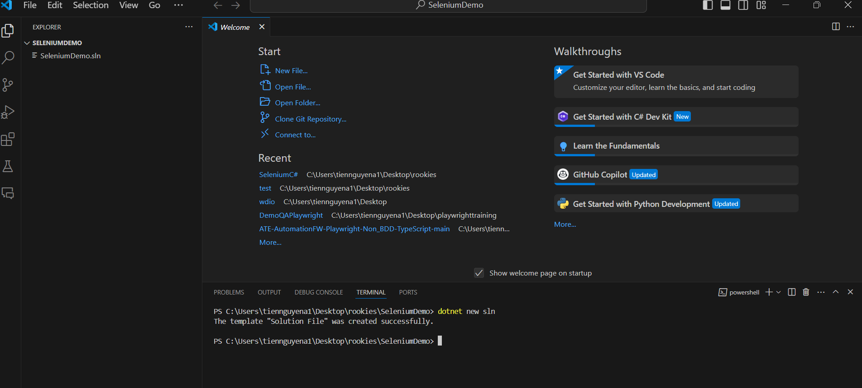
Add a solution file to this folder
Execute following command in Terminal Window: dotnet new sln
https://learn.microsoft.com/en-us/dotnet/core/tools/dotnet-new

Slide 37
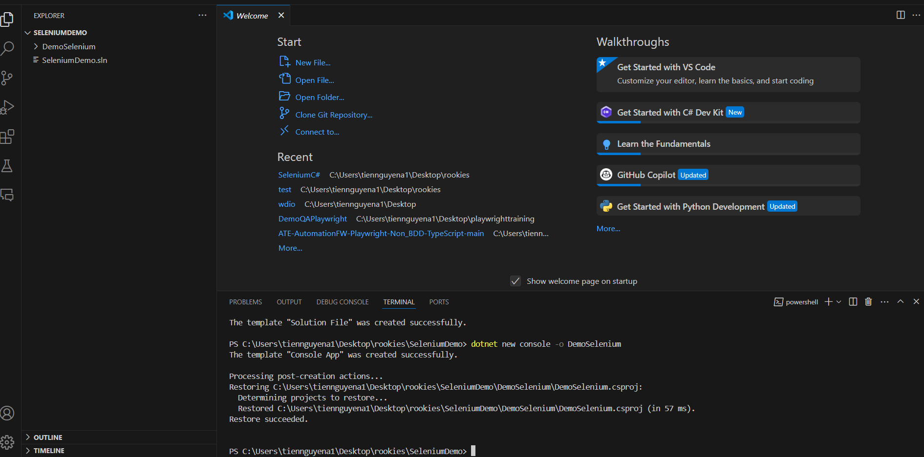
Create Console App(.Net Framework) project
Execute following command in Terminal Window: dotnet new console -o DemoSelenium

Slide 38
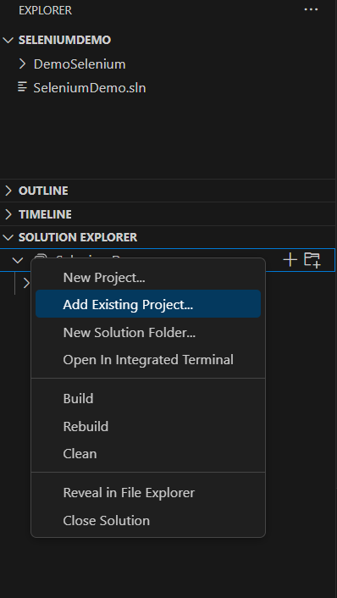
Add the project into the solution
Restart VSCode and add the project to the solution

Slide 39
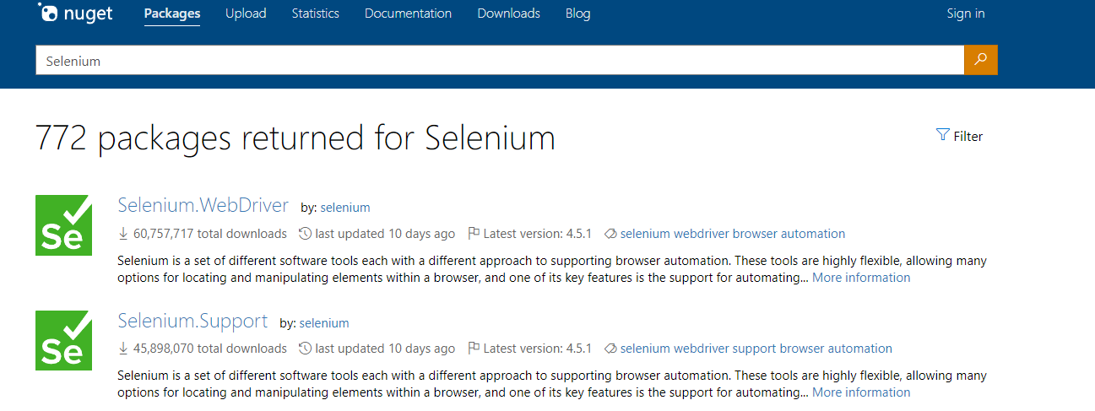
Search package from Nuget package page
Open Nuget packager market place: https://www.nuget.org/ Search for Selenium

Slide 40
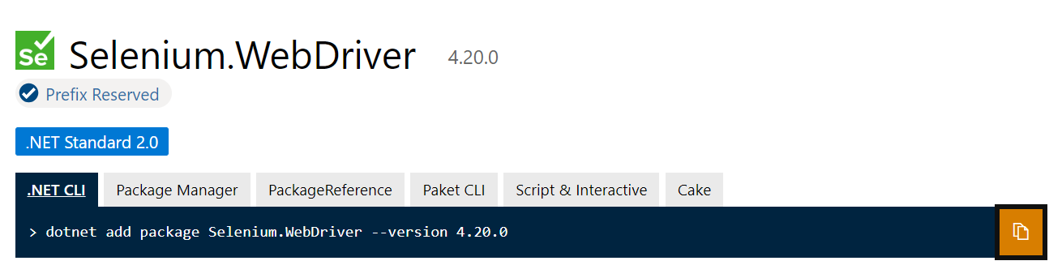
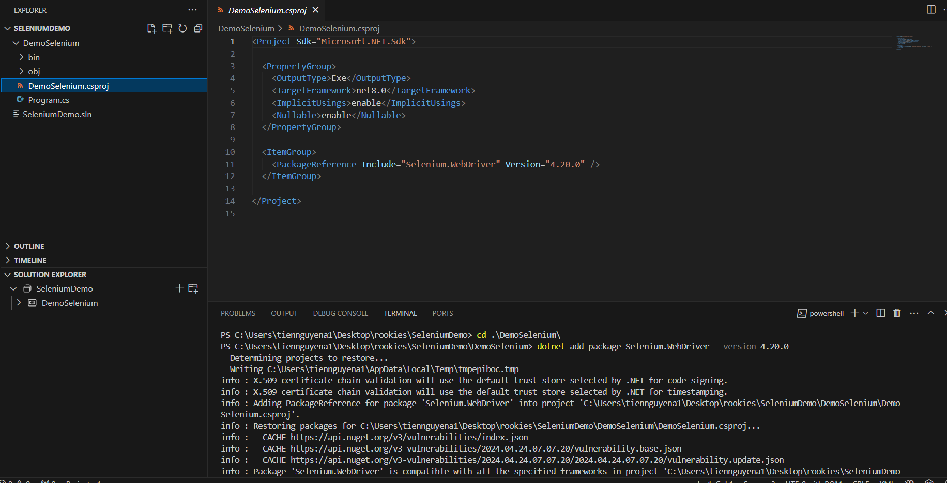
Install Selenium Webdriver library from Nuget package
Execute following command in Terminal Window (please note that we should in folder which contains csproj file before executing the command)
https://learn.microsoft.com/en-us/dotnet/core/tools/dotnet-add-package

Slide 41
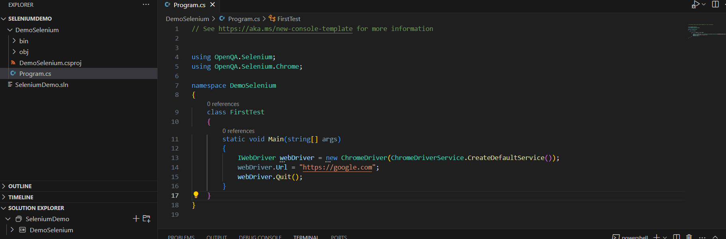
Initialize your Webdriver in code

Slide 42
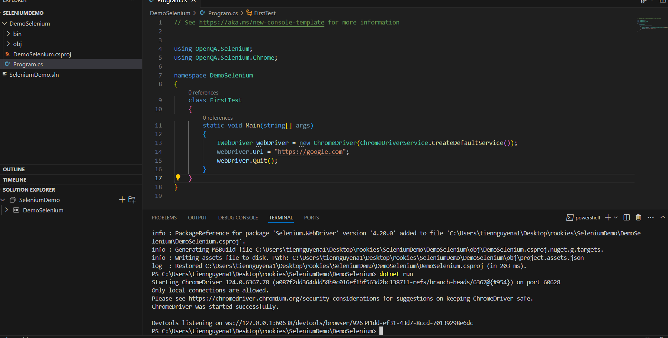
Running code
Execute “dotnet run” to run the program

Slide 43
Selenium WebDriver Methods

Slide 44
Selenium WebDriver Methods
WebDriver
Create new instance of WebDriver
Find element
Browser Commands
WebElement Commands
Dropdown Commands
Wait

Slide 45
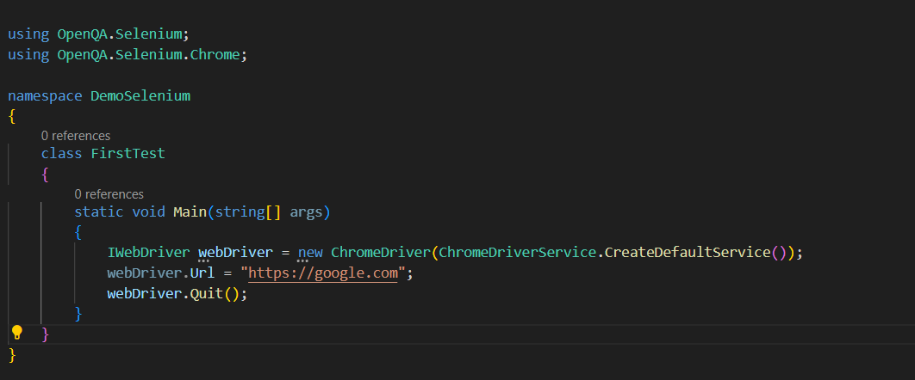
Create new instance of WebDriver

Slide 46
Find Element
findElement
IWebElement element = driver.FindElement(By.XPath(“//button[text()=‘Some text’”));
findElements
List<IWebElement> elements = driver.findElement(By.XPath(“//button"));
findElement | findElements
Throws NoSuchElementException if the element is not found | Returns an empty list if no matching element is found
Detects a unique web element | Return a collection of matching elements

Slide 47
Browser Commands:
Command Name | Description | Syntax
Url Command | This command is used to open a specified URL in the browser. | driver.Url = "https://www.google.com"
Title Command | This command is used to retrieve the page title of the web page that is currently open | String title = driver.Title
PageSource Command | This command is used to retrieve the source code of web page that is currently open. | String pageSource = driver.PageSource
Close Command | This command is used to close the recently opened browser instance. | driver.Close();
Quit Command | This command is used to close all open browser instances | driver.Quit();
Back Command | This command is used to navigate to the previous page of browser history. | driver.Navigate().Back();
Forward Command | This command is used to navigate to the next page of browser history. | driver.Navigate().Forward()
Refresh Command | This command is used to perform browser refresh. | driver.Navigate().Refresh()
https://www.selenium.dev/documentation/webdriver/browser/

Slide 48
WebElement Commands:
Command Name | Description | Syntax
Click command | This command is used to click on a Webelement. For the element to be clickable, the element must be visible on the webpage. This command is used for checkbox and radio button operations as well. | IWebElement element = driver.FindElement(By.xpath("xpath of WebElement")); element.Click();
Clear command | This command is specifically used for clearing the existing contents of textboxes. | IWebElement element = driver.FindElement(By.xpath("xpath of WebElement")); element.Clear();
SendKeys command | This command is used to input a value onto text boxes. The value to be entered must be passed as a parameter to | IWebElement element = driver.FindElement(By.xpath("xpath of WebElement")); element.SendKeys("guru99");
Displayed command | This command is used to identify if a specific element is displayed on the webpage. This command returns a Boolean value; true or false depending on the visibility of web element. | IWebElement element = driver.FindElement(By.xpath("xpath of WebElement")); Boolean status = element.Displayed;
Enabled command | This command is used to identify if a particular web element is enabled on the web page. This command returns a Boolean value; true or false as a result. | IWebElement element = driver.FindElement(By.xpath("xpath of WebElement")); Boolean status = element.Enabled;
Selected command | This command is used to identify if a particular web element is selected. This command is used for checkboxes,radio buttons, and select operations. | IWebElement element = driver.FindElement(By.xpath("xpath of WebElement")); Boolean status = element.Selected;
Submit command: | This command is similar to click command, The difference lies in whether the HTML form has a button with the type Submit. While the click command clicks on any button, submit command clicks on the only the buttons with type submit. | IWebElement element = driver.FindElement(By.xpath("xpath of WebElement")); element.submit();
Text command | This command returns the innertext of a Webelement. This command returns a string value as a result. | IWebElement element = driver.FindElement(By.xpath("xpath of WebElement")); String text=element.Text;
TagName command | This command returns the HTML tag of a web element. It returns a string value as the result. | IWebElement element = driver.FindElement(By.xpath("xpath of WebElement")); String tagName = element.TagName;
GetCSSValue Command: | This method is used to return the color of a web element on the form of a rgba string (Red,Green,Blue, and Alpha). | IWebElement element = driver.FindElement(By.xpath("xpath of WebElement")); String color = element.getCSSValue;Output– If the color of element is red, output would be rgba(255,0,0,1)

Slide 49
Dropdown Commands:
Command Name | Description | Syntax
SelectByText Command | This command selects an option of a dropdown based on the text of the option. | IWebElement element = driver.FindElement(By.xpath("xpath of WebElement")); SelectElement select = new SelectElement(element); select.SelectByText("Guru99");
SelectByIndex Command | This command is used to select an option based on its index. Index of dropdown starts at 0. | IWebElement element = driver.FindElement(By.xpath("xpath of WebElement")); SelectElement select = new SelectElement(element); select.SelectByIndex("4");
SelectByValue Command | This command is used to select an option based on its option value. | IWebElement element = driver.FindElement(By.xpath("xpath of Webelement")); SelectElement select = new SelectElement(element); select.SelectByValue("Guru99");
Options Command | This command is used to retrieve the list of options displayed in a dropdown. | IWebElement element = driver.FindElement(By.xpath("xpath of WebElement")); SelectElement select = new SelectElement(element); List<IWebElement> options = select. Options; int size = options.Count; for(int i=0;i<options.size();i++) { String value = size.elementAt(i).Text; Console.writeLine(value); }The above code prints all the options onto console within a dropdown.
IsMultiple command | This command is used to identify if a dropdown is a multi select dropdown; A multi select dropdown enables user to select more than one option in a dropdown at a time. This command returns a Boolean value. | IWebElement element = driver.FindElement(By.xpath("xpath of WebElement")); SelectElement select = new SelectElement(element); Boolean status = select.IsMultiple();
DeSelectAll command | This command is used in multi select dropdowns. It clears the options that have already been selected. | IWebElement element = driver.FindElement(By.xpath("xpath of WebElement")); SelectElement select = new SelectElement(element); select.DeSelectAll();
DeSelectByIndex command | This command deselects an already selected value using its index. | IWebElement element = driver.FindElement(By.xpath("xpath of WebElement")); SelectElement select = new SelectElement(element); select.DeSelectByIndex("4");
DeSelectByValue command | This command deselects an already selected value using its value. | IWebElement element = driver.FindElement(By.xpath("xpath of WebElement")); SelectElement select = new SelectElement(element); select.DeSelectByValue("Guru99");
DeSelectByText command | This command deselects an already selected value using its text. | IWebElement element = driver.FindElement(By.xpath("xpath of WebElement")); SelectElement select = new SelectElement(element); select.DeSelectByText("Guru99");

Slide 50
Waits

Slide 51
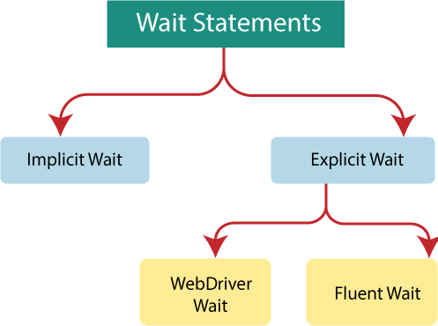
Waits
https://www.selenium.dev/documentation/webdriver/waits/

Slide 52
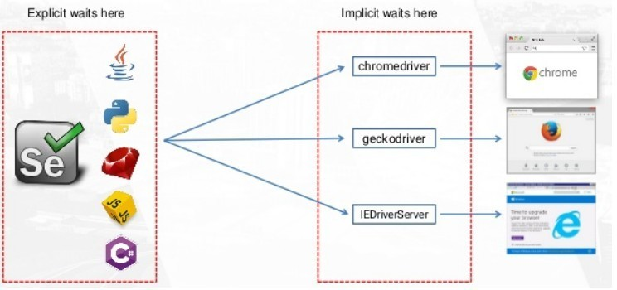
Waits

Slide 53
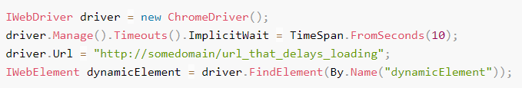
Waits
Implicit Wait:
- An implicit wait is to tell WebDriver to poll the DOM for a certain amount of time when trying to find an element or elements if they are not immediately available
- The default setting is 0, meaning disabled. Once set, the implicit wait is set for the life of the session.
➔ Do not mix implicit and explicit waits. Doing so can cause unpredictable wait times.

Slide 54
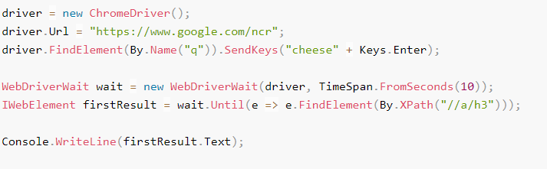
Waits
Explicit Wait: It allows your code to halt program execution, or freeze the thread, until the condition you pass it resolves. The condition is called with a certain frequency until the timeout of the wait is elapsed.
The conditions available in the different language bindings vary, but this is a non-exhaustive list of a few:
alert is present
element exists
element is visible
title contains
title is
element staleness
visible text
➔ a good fit for synchronising the state between the browser and its DOM, and your WebDriver script.

Slide 55
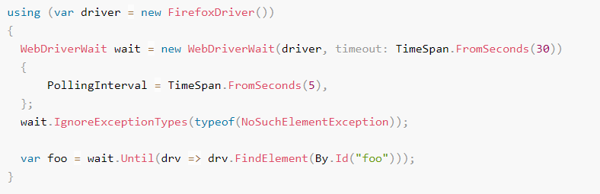
Waits
Fluent Wait:
- Defines the maximum amount of time to wait for a condition, as well as the frequency with which to check the condition
- Users may configure the wait to ignore specific types of exceptions whilst waiting, such as NoSuchElementException when searching for an element on the pag

Slide 56
Waits
▪Explicit
Client Side (Selenium Side)
Can wait for anything
Explicit Usage
TimeoutException
▪Implicit
Driver Side
Element appeared in DOM
Work automatically
NoSuchElementException
Please try to avoid hard sleep in your script

Slide 57



Slide 58
Homework
Implement the below test script
- Test Application: http://192.168.237.10:3000
- Account (User name: Admin2Pass, qp$#tGu^)
Scenario 1: Create new project
Given the user logs into the application
And the user is on Create Project page
When the user fills in all project information
And the user clicks Create button
Then all information of the project is shown.

Slide 59
Homework
Scenario 2: Search project
Given the user logs into the application
And the user is on the Search Project page
When the user applies some search criteria
And the user clicks on Search button
Then all projects matched with input criteria will be displayed.

Slide 60



Slide 61
References
https://www.selenium.dev/documentation
https://learn.microsoft.com/en-us/dotnet/core/tools/dotnet-new-sdk-templates
https://www.nuget.org/packages

